Slide 1
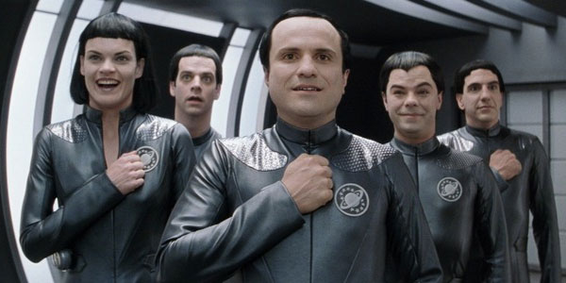
Significant factors of movie Ratings

Slide 2
Can we know if a movie will be loved?
To find out, I extracted information from Wikipedia on:
Actors
Box Office
Budget
Composers
Editors
Producers
Production Companies

Slide 3

Feature thought Process
Proxy for Movie Popularity:
Box Office
Proxy for Movie Potential:
Potentials of Actors, Composers,
Editors, Producers,
Production Company
Budget?
Not Useful

Slide 4
Features
For Box Office, used USD non-null Values
For Actors, Composers, Editors, Producers, and Production Companies:
Super: If in more than 2 movies (Binned)
Mega: If in more than 3 movies (Binned)
Ultra: If in more than 4 movies (Dummy)

Slide 5
For Example
Keanu Reeves is in 1 movie, so he doesn’t go into any column
Clint Eastwood is in Mega, so he gets a value of 1 for the Super and Mega columns
Hans Zimmer is in Ultra, so he is in Super and Mega and gets his own column
 | Super Actor | Mega Actor | Super Composer | Mega Composer | Hans Zimmer
Keanu Reeves | 0 | 0 | 0 | 0 | 0
Clint Eastwood | 1 | 1 | 0 | 0 | 0
Hans Zimmer | 0 | 0 | 1 | 1 | 1

Slide 6
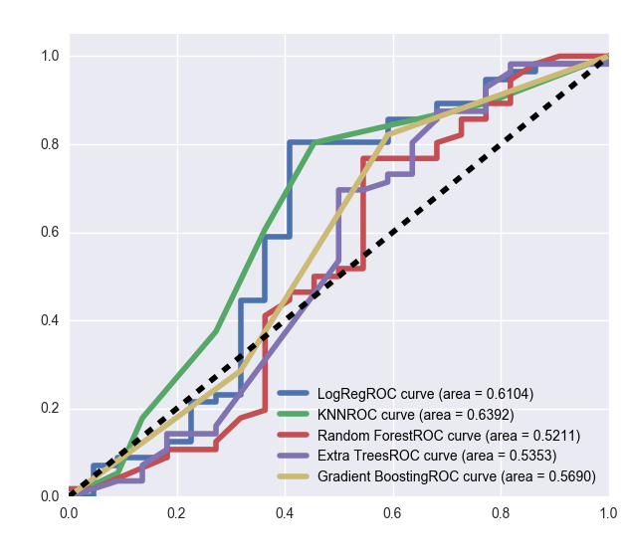
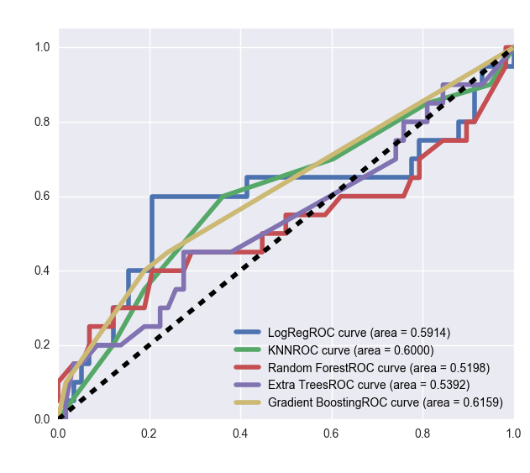
Used KNN, Logreg, and Trees to Categorize imdb rating

Slide 7
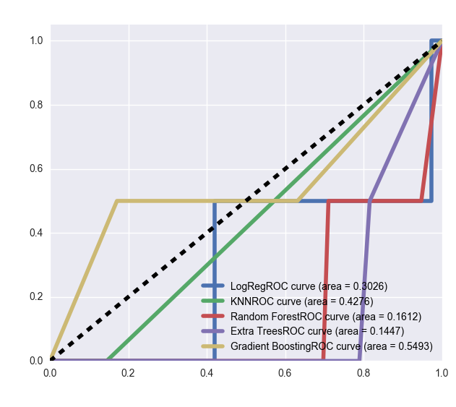
Used KNN, Logreg, and Trees to Categorize imdb rating

Slide 8
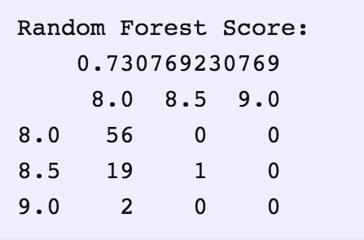
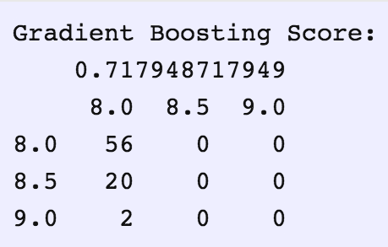
Top Model Confusion Matrices

Slide 9
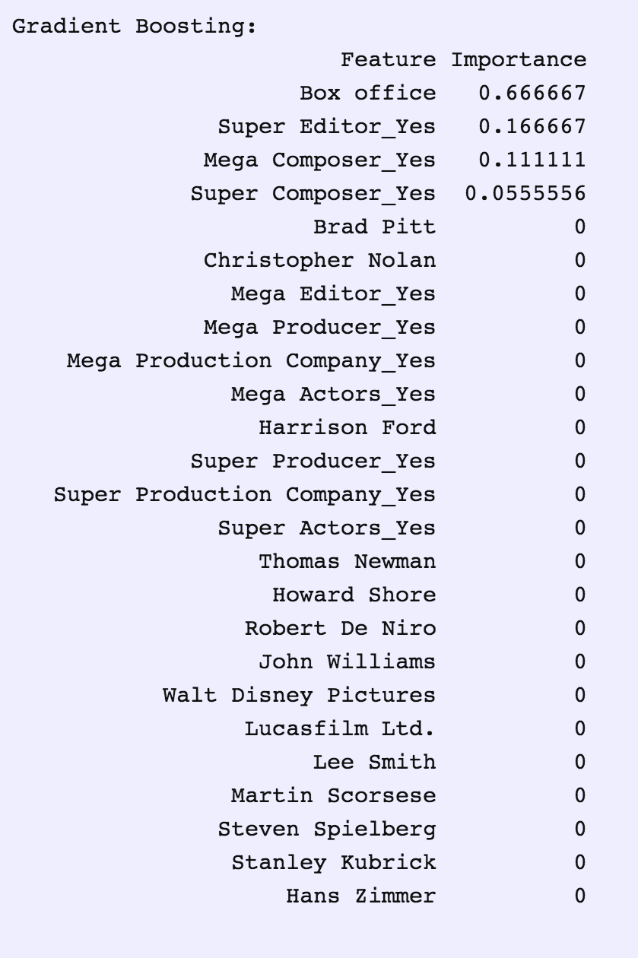
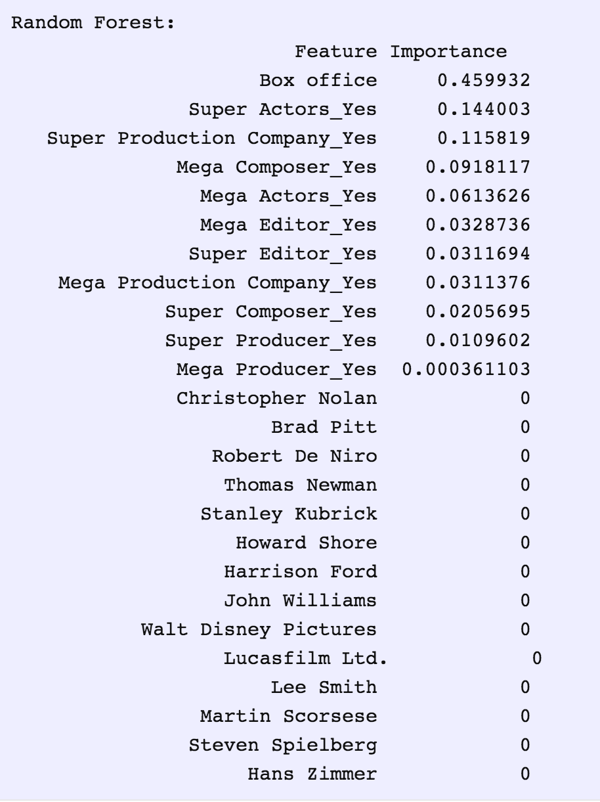
Feature Importance with gridsearching

Slide 10
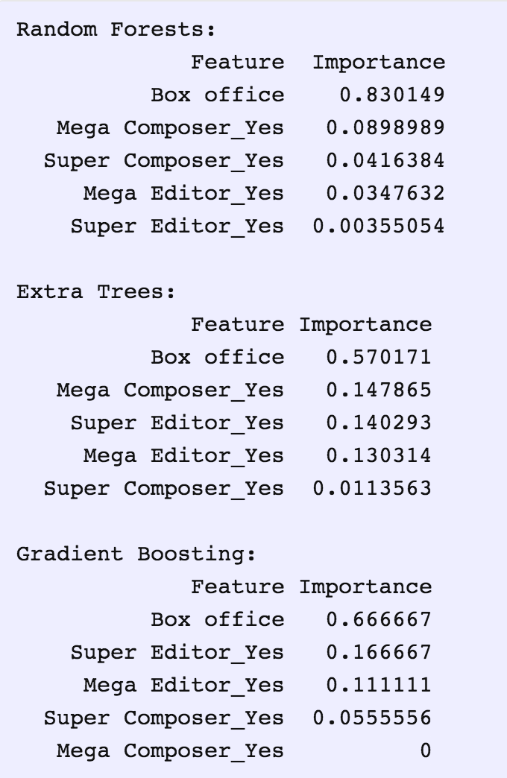
Feature importance for top features; no gridsearch

Slide 11


Questions?

